Slide 1
Zero hunger
A web application to make food available to the needy

Slide 2

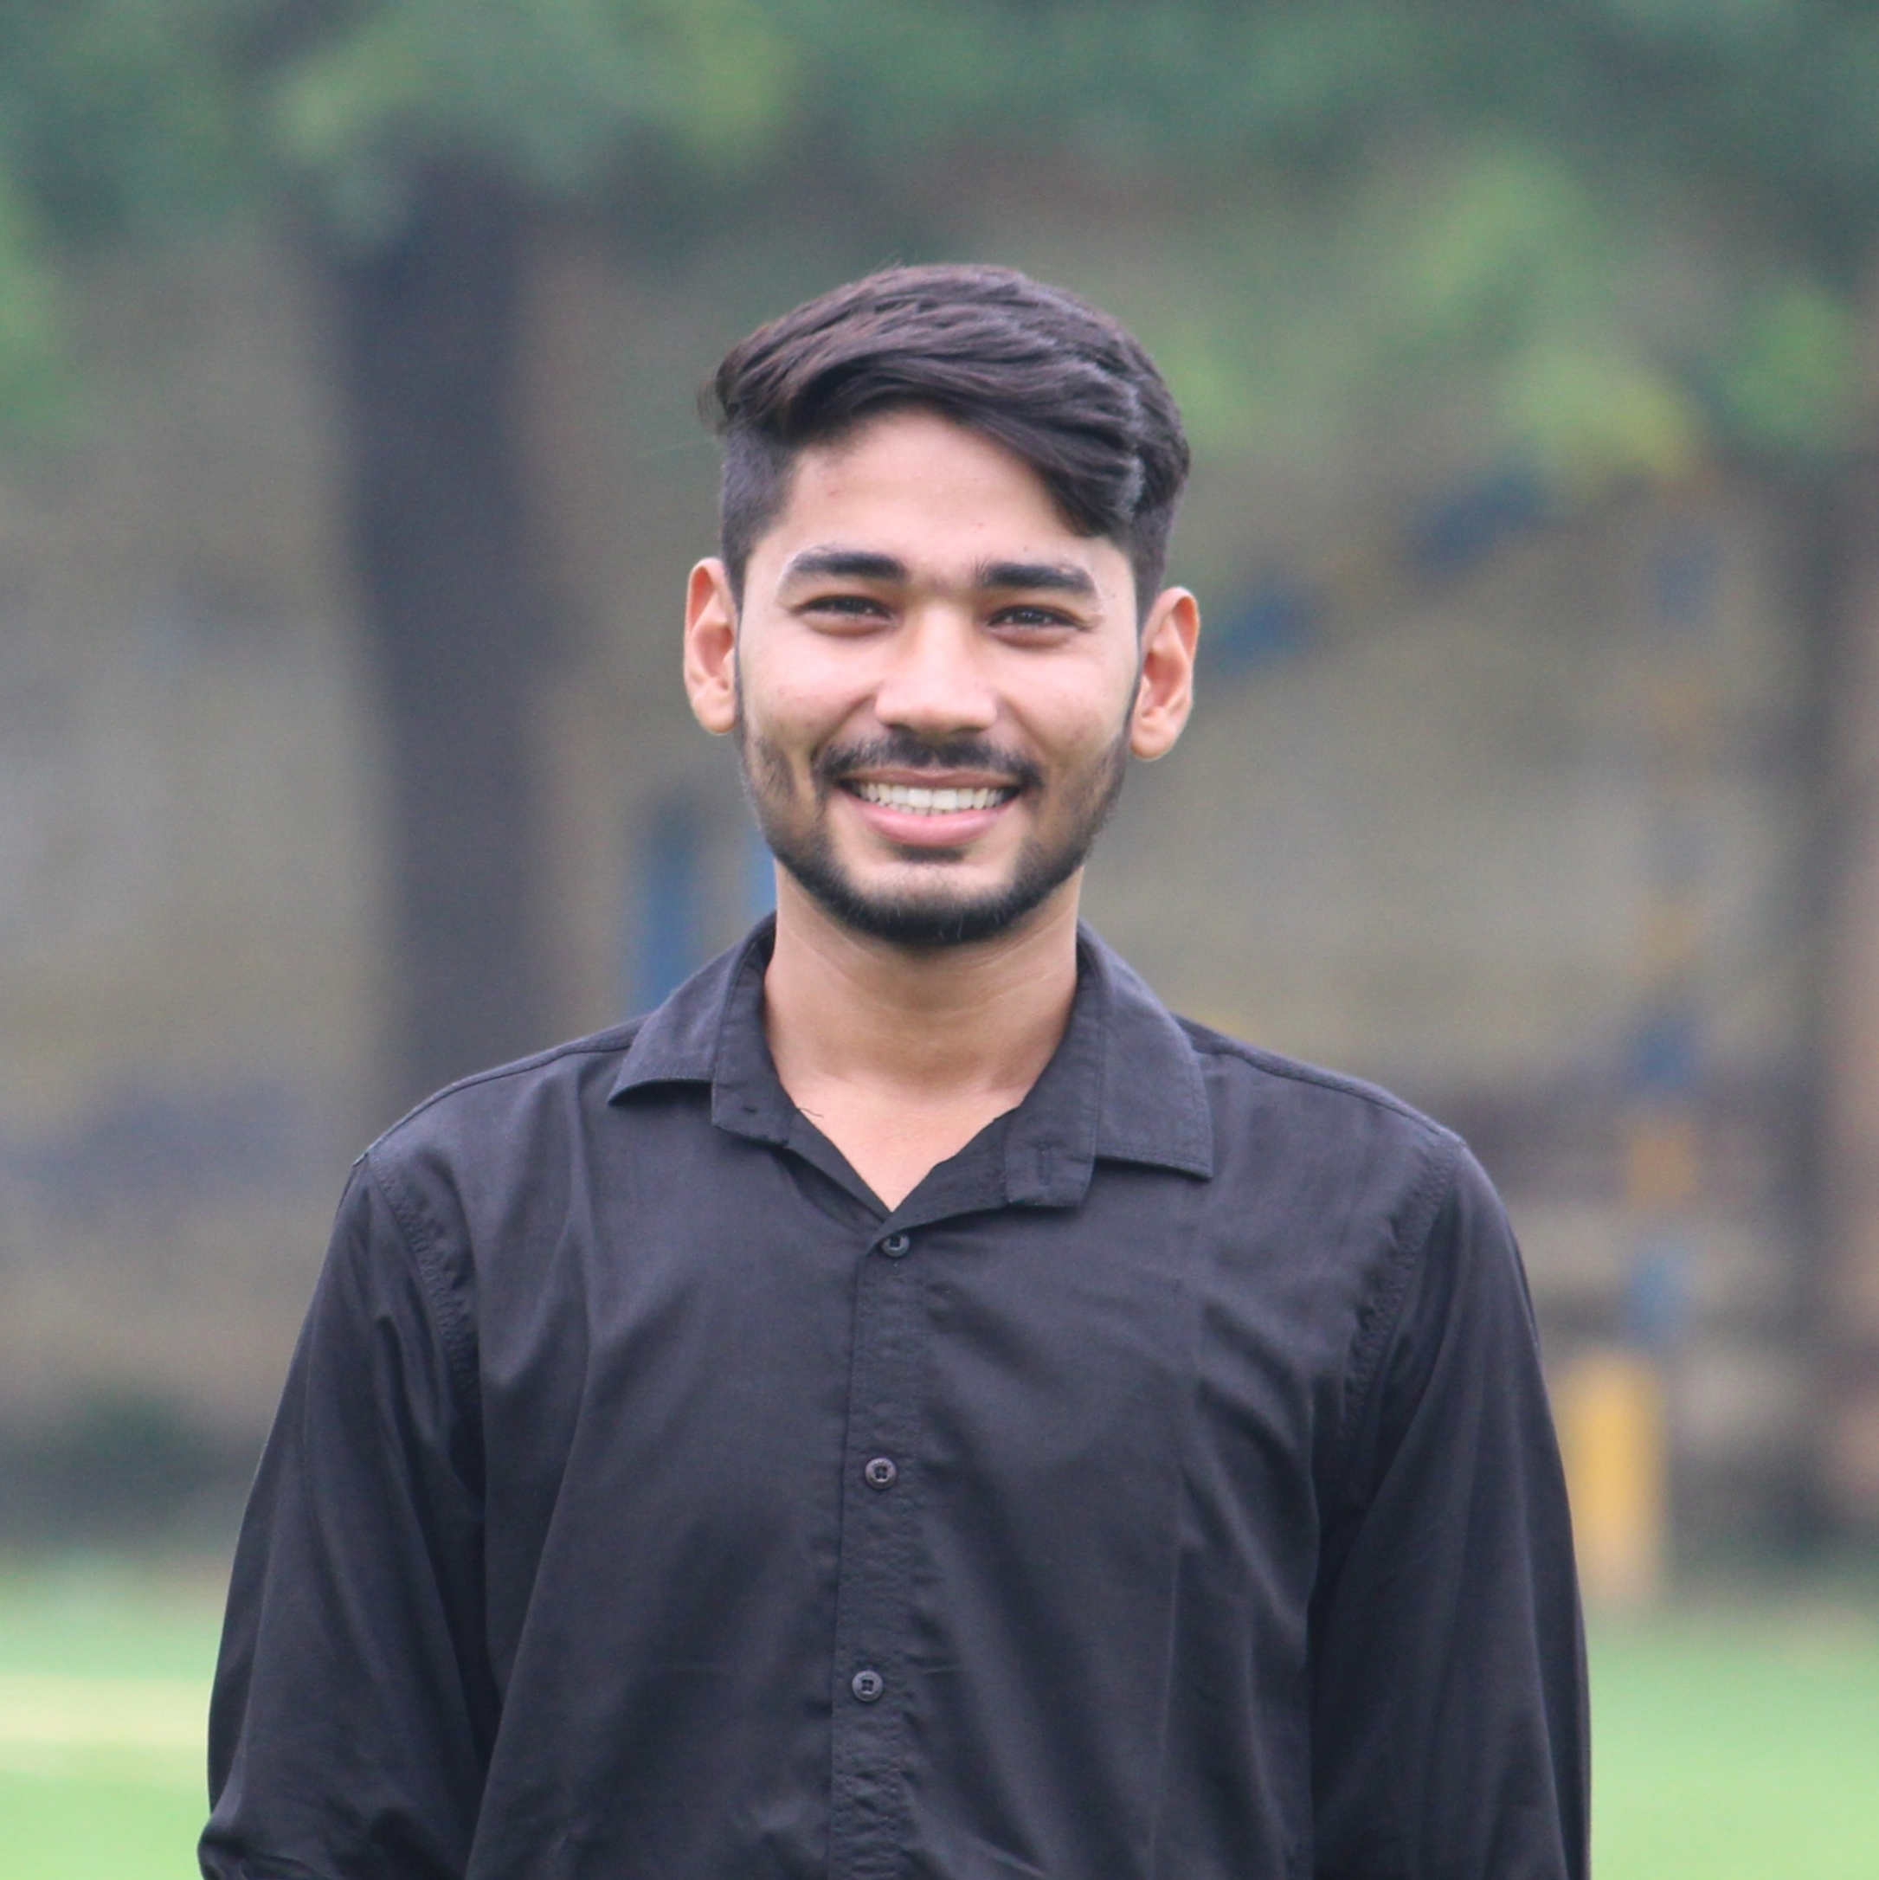


Our team
Navneet chaudhary
Madhav sharma
Nitish gupta
Peeyush tyagi
2200290140097
2200290140083
2200290140102
2200290140108

Slide 3
introduction
The basic concept of this project entitled “Web based application for Food Waste Management” is to collect the excess/leftover food from donors such as hotels, restaurants, marriage halls, etc and distribute to the needy people through NGOs.

Slide 4




Software requirements
My sql
bootstrap
Vs studio
xampp

Slide 5
Hardware requirements
Windows , Mac OS
Storage : 2 GB or Higher
RAM : 3 GB or Higher
Processor : 1.5 GHz dual-core or Higher

Slide 6
modules
1. Admin
View the request raised by Donor, NGO and logistics.
Accept or deny the request from the users after verify true information or not.
Mapping the Logistics with NGO and Donor.
View the complaints and suggestions about the requests and can reply it.
2. Donor
Register with name, username, password and some personal information.
Login with registered Username and password.
Raise the request with details like date, number of packets that can be sent and location.
View the raised requests and can view the status regarding whether the request is accepted or denied by the Admin.

Slide 7
3. NGO(Non-Governmental Organization)
Register with name, username, password and some personal information.
Login with registered Username and password.
Raise the request with details like date, number of packets needed and location.
View the raised requests and can view the status regarding whether the request is accepted or denied by the Admin.
4. Logistics
Register with name, username, password and some personal information.
Login with registered Username and password.
Raise the request with vehicle no, vehicle name, driver name.
View the raised requests and can view the status regarding whether the request is accepted or denied by the Admin.

Slide 8
OUtput
In the home page, the users have to be registered in various roles such as Donor, NGO or Logistics.
After registration, they can raise the requests with the availability for donors, requirements for NGOs and vehicle details in their respective logins.
Then the admin can login to his environment and can either accept or deny the requests of the donor and the NGO. And also he will map the Donor with NGO along with the logistics, using the mapping feature available in the website.

Slide 9
conclusion
This website helps in collecting the leftover/excess food from the Donors and distributing the same to those who are in need.
This web-based application works properly and responsive to the users with proper retrieval from the database.
Also, there is a help menu available in all user logins which is answered by the admin.
In this way this website comes with various features for the effective consumption of waste food by the needy people

Slide 10
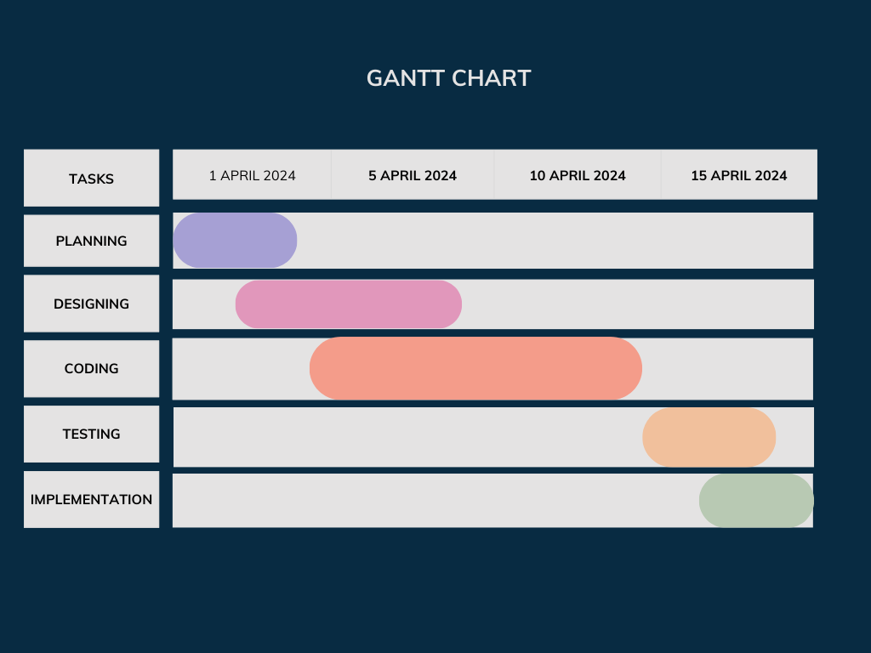
Gantt chart

